Slide 1

Game of Stocks Report
Investment Strategy
Student Name:
Neptun Code:
Final Game Rank:
ZCQBT5
MD ABDULLAH
28

Slide 2



The Hard Numbers: Financial Dashboard
$10000
$9932
-$67
-0.67%
Starting Capital
Ending Net Worth
Total Gain/Loss
Overall Return
Cash Remaining
Buying Power
Borrowed Cash
$0.00
$2,205.72
$7,727.18
Platform Used: MarketWatch

Slide 3



Methodology: Trading Approach
News-Driven Decisions
Buy/sell based on news: acquisitions, earnings, sentiment.
Core Philosophy
"React fast to news. Buy with strong momentum, avoid deep analysis."

Slide 4


Performance Narrative & Risk
Early Volatility
News-driven trades caused small up/down movements.
Mid-Game Mix
Positive announcements and negative news led to mixed results.
Stabilized Loss
Portfolio stabilized, but remained slightly below initial capital.
Small Overall Loss
Portfolio finished with a slight loss.
Risk Profile: Moderate
Large positions based on news, without leverage.

Slide 5

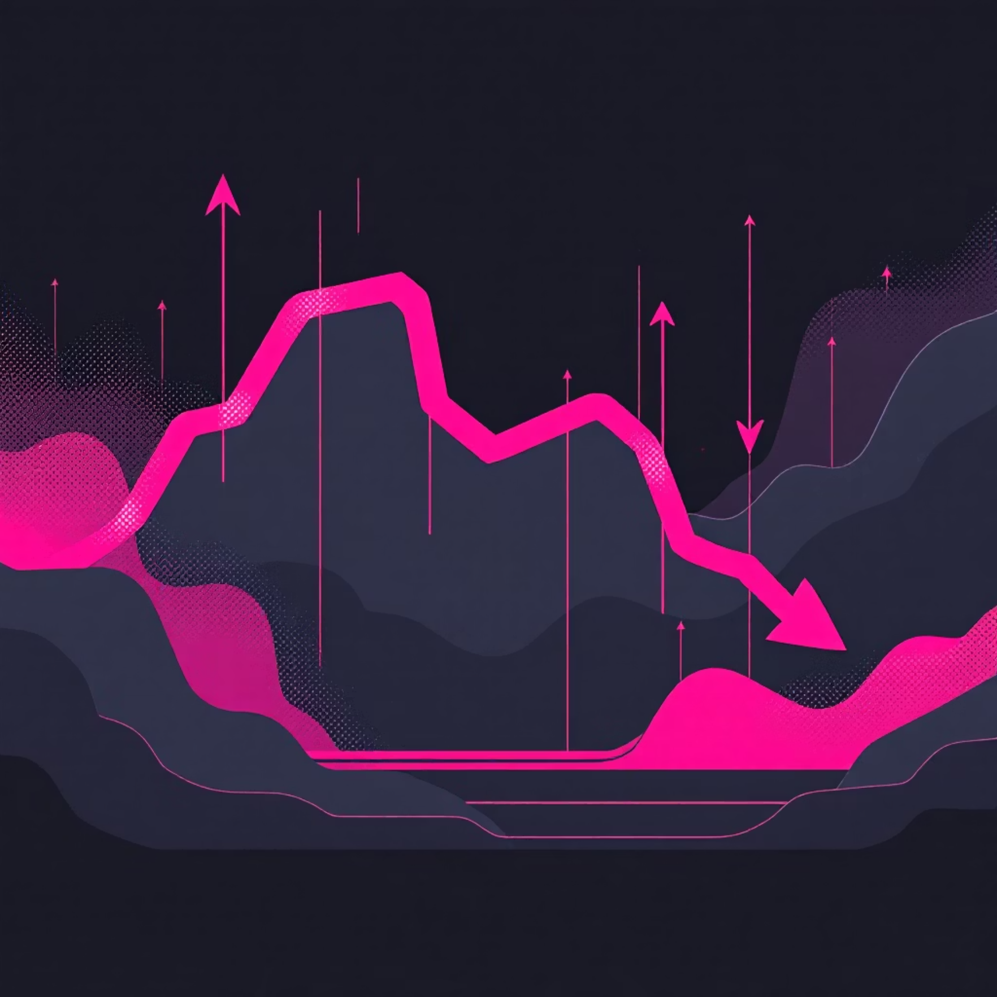
Evidence: Best & Worst Trades
Best Trades
Worst Trades
MS — +1.18% (+$124.16)
ETH — –25.17% (–$217.80)
AVGO — +4.99% (+$16.73)
BLK — –7.16% (–$251.19)
VSPGX — +2.62% (+$28.78)
NKE — –9.46% (–$66.00)
RDDT — +0.17% (+$0.35)
CRNX — –6.63% (–$30.50)
MRM — –14.46% (–$35.00)
PEP — –5.41% (–$8.29)

Slide 6

Final Reflection
Strategy Outcome
Slight loss, close to break-even.
News Trading Lesson
Unpredictable; quick gains and sudden losses.
Future Approach
More structured strategy needed (momentum, technicals, diversification).
Next Steps
Diversify, use stop-losses, avoid over-concentration.

Slide 7
Thank you…

