Slide 1

Game of Stocks
Investment Strategy Report
Md Khalekuzzaman | Neptun Code: CKWQ0V | Final Rank: 9

Slide 2
Portfolio Dashboard
A comprehensive snapshot of performance metrics from the MarketWatch simulation demonstrates disciplined capital management and strategic growth.
$10K
$10,806
8.06%
$806
Starting Capital
Ending Net Worth
Overall Return
Overall Gain
Initial investment base
Final portfolio value
Total gain percentage
Absolute profit realized
Capital Structure
Platform & Risk Profile
Cash Remaining: $1,861.37
Platform: MarketWatch Virtual Stock Exchange
Buying Power: $12,666.99
Leverage Used: None
Cash Borrowed: $0
Risk Approach: Conservative, fundamentals-based
Short Reserve: $0

Slide 3

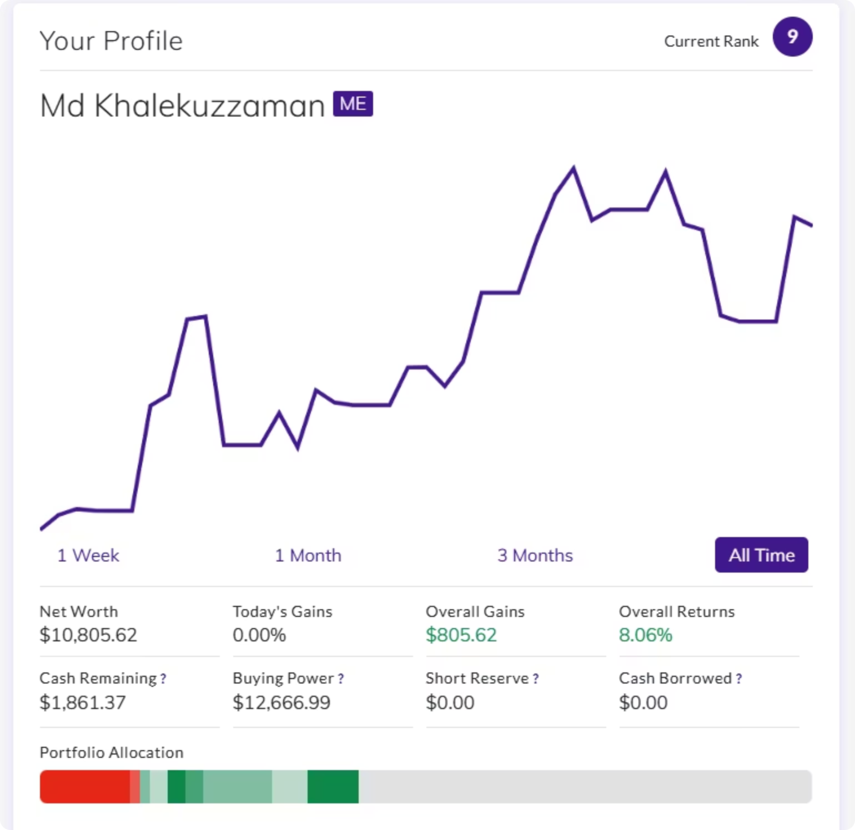
Performance Narrative
Portfolio Performance Overview
Risk Management
The full portfolio chart shows steady growth based on careful decisions and controlled risk.
Strategy Type: Moderate Growth
No margin or borrowed money used
In the beginning, there were some ups and downs as I entered my positions.
No short selling
In the middle period, the portfolio grew strongly because the tech sector performed well.
Invested mainly in strong, well-known companies
Near the end, there was a small drop, but the portfolio recovered and stayed stable.
Reduced risk by buying competitors in the same industry
Overall, the portfolio kept moving upward with low volatility.

Slide 4




Investment Methodology
Competitive Hedging Strategy
Quality-First Selection
Fundamental Analysis
Purchased two competitors within the same industry to create balanced exposure and reduce single-stock risk while capturing sector growth.
Focused exclusively on top-performing, fast-growing companies with proven track records: MSFT, NVDA, AMD, AMZN, and LLY.
Prioritized strong fundamentals, robust earnings strength, and clear sector growth trends over speculative opportunities.
Buy Signal Triggers
01
02
03
Earnings Momentum
Sector Leadership
Macro Alignment
Companies demonstrating strong upward earnings trajectory and consistent beat rates
Clear market dominance and competitive advantages within their respective industries
Positive macroeconomic indicators including GDP expansion and technology sector tailwinds
Golden Rule: "Buy leading companies and their strongest competitors to balance risk and secure growth." This approach delivered an 8.06% return, outperforming many passive strategies while maintaining lower volatility than concentrated positions.

Slide 5

Trade Performance Analysis
Learning Opportunities
Top Performers
Strategic selections in technology and healthcare sectors drove substantial gains, validating the fundamental approach.
NVIDIA (NVDA)
+$1,931.60
AI chip dominance
AMD
+$1,425.12
Moderna (MRNA)
Semiconductor growth
Loss: –$14.00
Minor setback in biotech sector representing less than 2% of total gains. This limited exposure to post-pandemic pharmaceutical volatility demonstrated effective position sizing.
Amazon (AMZN)
+$498.20
E-commerce resilience
Microsoft (MSFT)
-$2,543.40
Eli Lilly (LLY)
Cloud computing leadership
+$172.95
Pharmaceutical innovation
All other positions generated positive returns, showcasing the strength of diversified quality selection and competitor-pairing strategy.

Slide 6
Conclusions
Strategy Validation
Growth Drivers
Risk Management Success
The mix of leading companies and their main competitors produced a strong 8.06% return without using any borrowed money, showing that solid fundamentals can beat speculative trading.
Technology stocks—especially NVDA, and AMD—were the main sources of growth, benefiting from trends in AI and digital transformation.
Only two stock MSFT and (MRNA) ended with a loss, and the impact was small.Using no leverage and pairing competitors helped protect the portfolio during market volatility.
Future Refinements
While this short-term simulation validated the core strategy, additional sophistication would enhance long-term performance:
Macroeconomic timing: Use central bank decisions and inflation trends to choose better entry and exit points.
Sector rotation: Create a system for moving investments between sectors depending on the economic cycle.
Position sizing: Adjust how much I invest in each stock based on volatility and confidence in the trade.
Technical Support Tools: Add basic momentum or trend indicators to help with better timing alongside fundamentals.
Key Takeaway: Disciplined fundamental investing combined with strategic diversification delivers consistent returns. The 8.06% gain in a competitive environment validates that patience and quality selection outperform short-term trading approaches.

